Slide 1
4. Design of combinational networks
Fondamenti di Elettronica
Sergio Spanò – spano@ing.uniroma2.it

Slide 2
Universal sets of gates
A set of gates is defined as “Universal” if any combinational system can be implemented using gates from that set.
We know from the previous lessons that all minterms and maxterms (and consequently any combinational circuit) can be implemented using the AND, OR and NOT gates
{AND,OR,NOT} is a universal set of gates

Slide 3
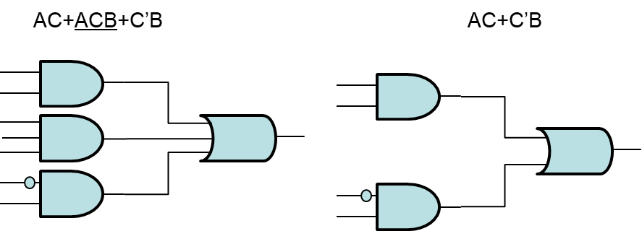
Minimization
Every boolean function can be made using a product of sums or a sum of producst (2 level network)
Different circuits can have same functionality.
In order to reduce the cost, it is necessary implement the minimal form

Slide 4
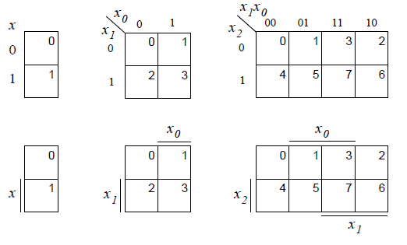
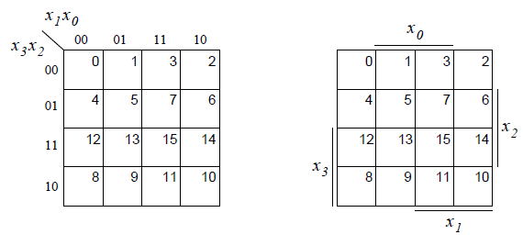

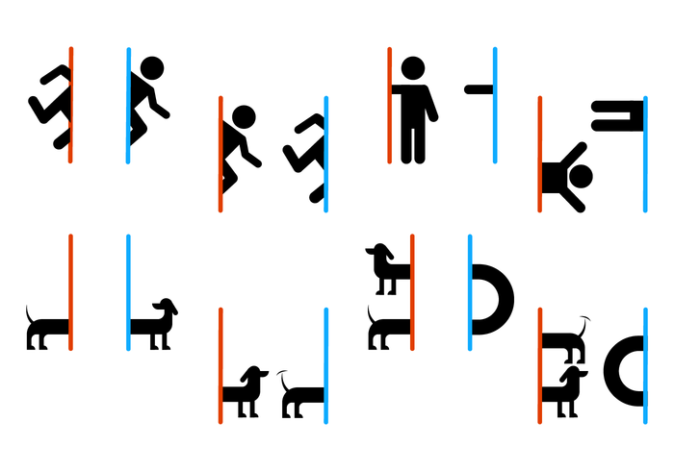

Karnaugh maps
The use of Boolean algebra may not be useful in case of complex expression.
A graphical representation of the boolean function helps the minimization: KARNAUGH MAP (K-map)
Gray coding
(only 1 bit changes)
The map wraps
Span where a variable doesn’t change
1 INPUT
2 INPUTS
3 INPUTS
4 INPUTS

Slide 5
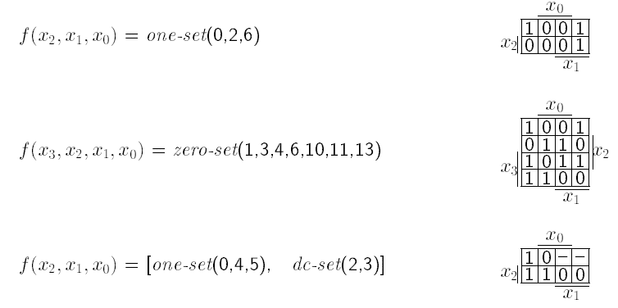
K-map: minterms and Maxterms
Minterm m_{j} correspond to “1” cell with label j
Maxterms M_{j} correspond to “0” cell with label j

Slide 6
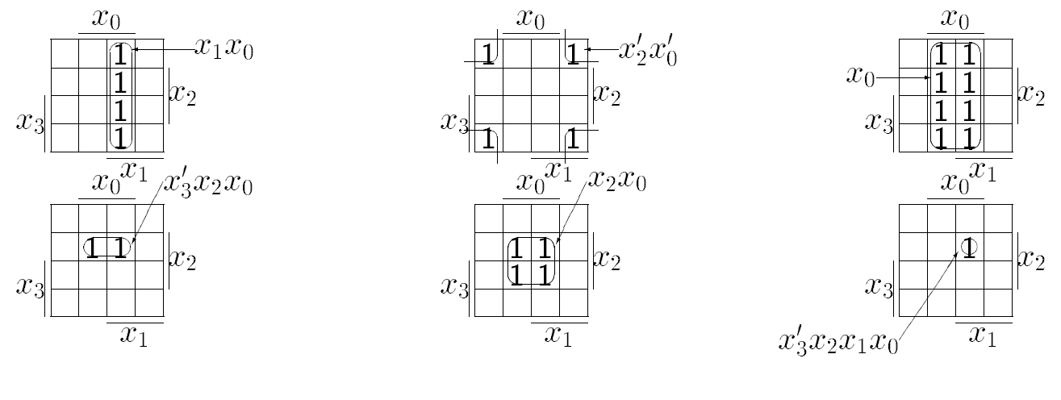
K-map: grouping
Only POWER-OF-TWO groupings are allowed (1, 2, 4, 8, 16, …)

Slide 7
Implicants
An IMPLICANT is a PRODUCT TERM for which f=1
PRIME IMPLICANT: An IMPLICANT not covered by another IMPLICANT
ESSENTIAL PRIME IMPLICANT: An IMPLICANT that covers at least a MINTERM not covered by other IMPLICANTS
In order to minimize Boolean functions using the KARNAUGH maps the following steps must be followed
Determine all PRIME IMPLICANTS
Obtain the ESSENTIAL PRIME IMPLICANTS
If not all 1-cell are covered it is necessary to choose a cover from the remaning PRIME IMPLICANTS

Slide 8
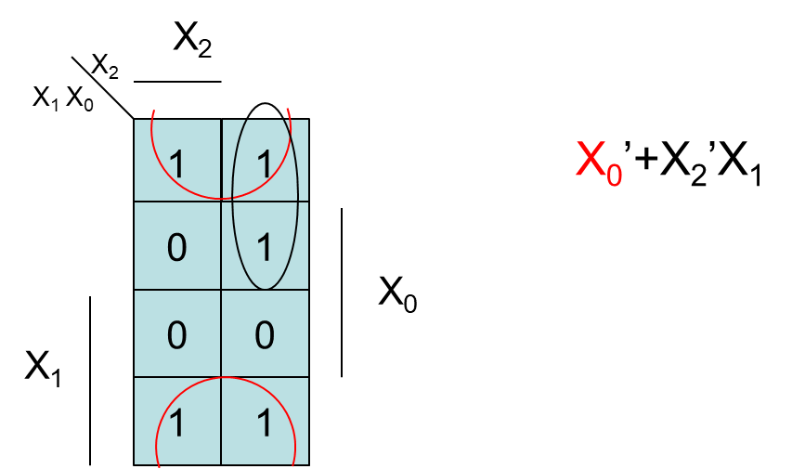
Minimization example 1: Sum of products
0 1
00 01 11 10

Slide 9
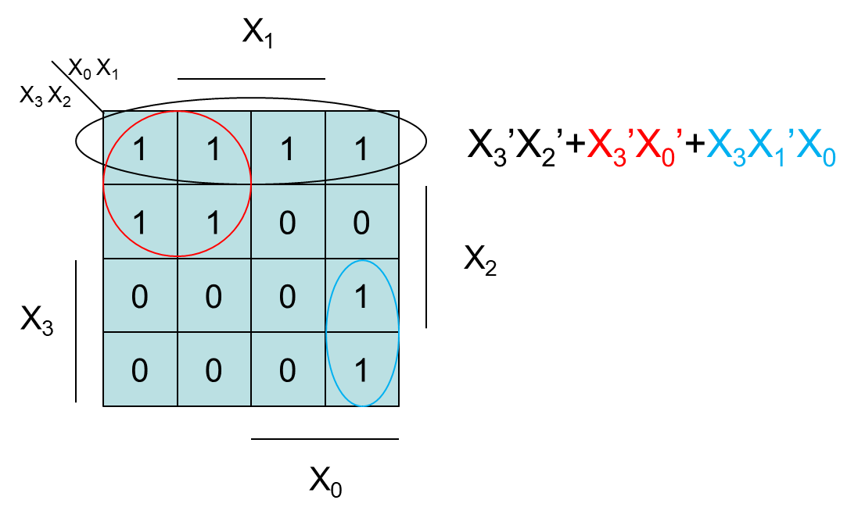
Minimization example 2: Sum of products
00 01 11 10
00 01 11 10

Slide 10
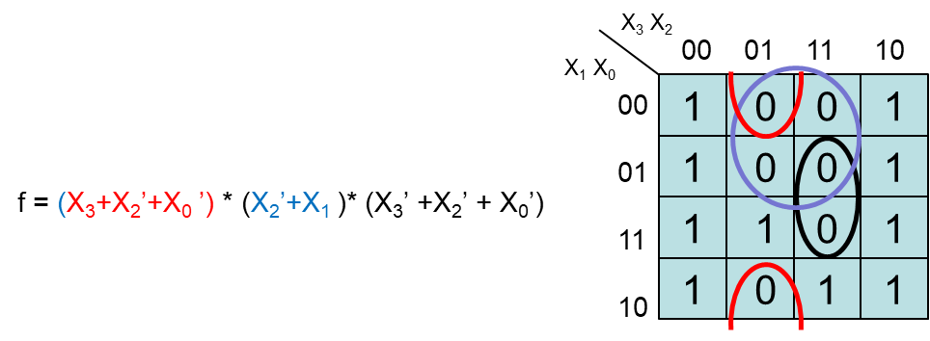




Minimization example 3: Products of sums
$$x_{2}$$
$$x_{0}$$
$$x_{1}$$
$$x_{3}$$

Slide 11
K-Map limitations
The KARNAUGH MAP method has some limitations
A limited number of input (5 if 2 maps are used)
Only 2 level circuits are implemented (sum of products or product of sums)
Large number of gates and irregular connections
Fan in and Fan out limitation

